Slide 1
Nowcasting in Africa : a vision for 2030
Andre KAMGA
Director General
14:45-15:00 UTC – 09:20
March 15, 2022
FROM FACTS TO A VISION AND HOW WE BRING THIS VISION ABOUT ?

Slide 2
Agenda
- FACTS ON NOWCASTING IN AFRICA
- VISION
- BRINGING THE VISION ABOUT

Slide 3
FACTS ON NOWCASTING
Very few NMHSs in Africa are exploiting Nowcasting SAF products available for more than a decade ago
High resolution deterministic and probabilistic forecasts products are yet to be applied in most African countries to estimate and communicate forecast uncertainties;
Current and future potential in Satellite product for health, DRR, food security and commodity trading, public infrastructure and transport are yet to tap into because of little efforts on satellite data, sector data ( water level) and actionable indices validated
Knowledge and understanding of meteorological processes and phenomena driving disasters are still limited ( e,g thresholds for significant impacts upcoming high spatial and spectral resolution MTG and EPS are opportunities)
Specific competencies on the use of future satellite and very high resolution convective permitting model outputs are lacking to better locate and assess severity of events

Slide 4
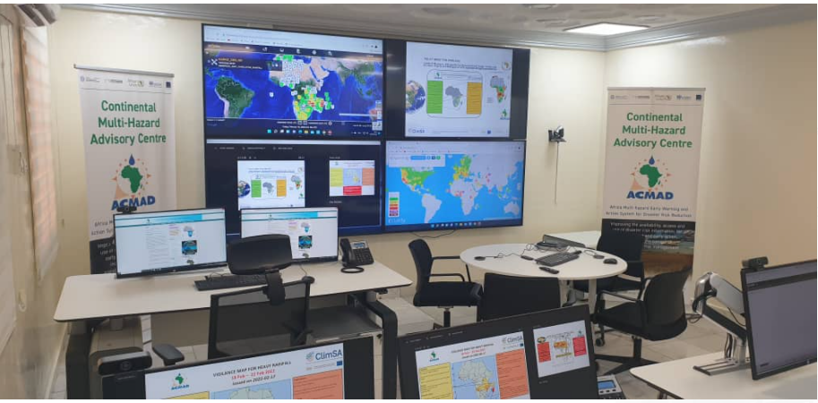
VISION
VISION FOR A DISASTER RESILIENT AFRICA with a network of MODERN, IMPACT BASED NOWCASTING systems and Services for sustainable and local development

Slide 5
BRING THE VISION ABOUT WITH
Rehabilitation of synoptic to national and local in situ observation stations for satellite data calibration and Product validation
High speed internet and upgrade of reception and high-performance computing stations and systems to better address high data volumes
Development of modern satellite data assimilation methods and tools with scientific visits, workshops and seminars leading to guides, training materials, methods, tools, new products transfer
Development of competencies on satellite derived services value chain with testbeds, FDPs, SOPs, OJT, Secondments, internships, fellowships
Sectors Users engagement and User interface operationalization strengthening for bespoke services and sustainability building

Slide 6
IMPLEMENTATION PARTNERS
WMO World Meteorological Centres, RSMCs on Nowcasting and NMCs
WMO Information System ( DCPCs in Africa, ENREN Network Africa Connect)
Operational Centres , Universities and Research Labs or centres active on Satellite derived Services
Research and innovation consortia ( Leeds , Pen State Universities , NMHS, Regional Centres,,,,)
User Organizations ( UNOCHA, UNDRR, UN WATER, WHO, UNDP, RIVER BASINS,,,,)

Slide 7
Thank you!
Questions are welcome.

