Slide 1

WorkPackage 7:
Capacity Development
Partners involved: ACMAD, WMO, BSC, MO, WEMC, UCT, SSSA
Main WP objectives:
Assess the training needs of climate service providers
Review and upgrade the training curricula on climate monitoring, forecasting, climate change projection and scenario development for impact studies
Develop and test training materials in collaboration with Intra ACP GFCS programme, RCOFs and other initiatives in Africa
Develop online training resources for inclusion in existing portals
  Capacity development gaps/needs and plan report (Task 7.1, M12) 95% ( Gaps analysis done and draft report prepared and undergoing review)
  Online course and modules (Task 7.2, M36) 0% (starting Sep 2021)
  Final report on project capacity development implementation and results (Task 7.3, M48) 0%
Notes:
This work package will contribute to developing the capacity of the regional NMHSs, SADC/CSC, research institutes and other identified climate service providers to generate tailored, science-based, innovative and technology driven climate products, information and services, in operational mode

Slide 2
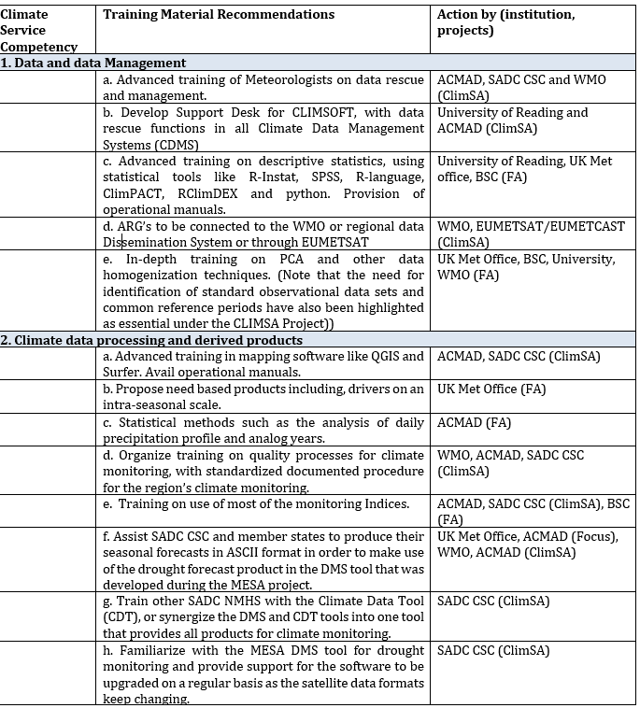
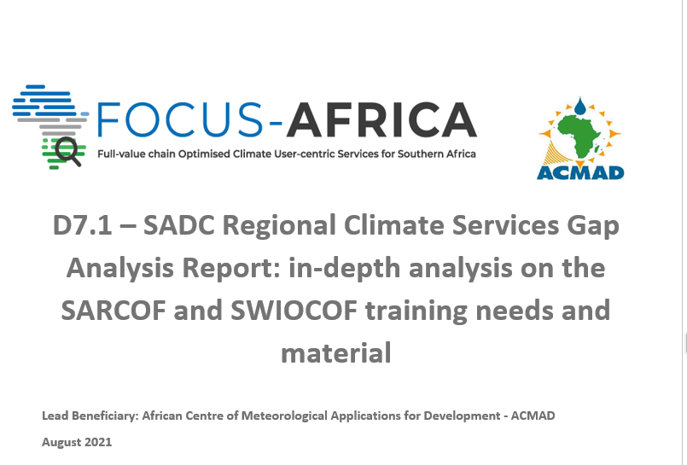
D7.1 Capacity gaps and capacity development plan plan
Literature Review
Data Collection: Compile Training Material from SARCOF/SWIOCOF
NMHSs survey on climate services implementation
Excel sheet with gap analysis – competency based (WMO1205)
Plan for addressing the gaps – recommendations + identification for different organizations and projects that could support
Notes:
Competency based gap analysis - Create and manage climate data sets; Derive products from climate data sets; Create and interpret climate forecasts and models; Ensure quality of climate forecasts; and Communicate information to users - as described in the WMO Guide to Competency (WMO-No. 1205). This report follows the format according to the competency-based framework

Slide 3
D7.1 A Capacity gaps and capacity development plan plan
Major gaps:
data collection, archiving and analysis tools ( Climsoft, R, R-INSTAT, CDT, Excel macro… ) and data visualization packages like QGIS
use of CPT with advanced statistical functionalities
drivers of southern Africa climate variability and predictors for climate forecasting in the region
Verification tools and related applications;
Interpretation of global single and multimodel ensemble outputs over the region
Verification, evaluation and model outputs intercomparison and comparisons with observations
Adherence to WMO standards and guidelines across various competency areas
Sub- seasonal forecasting – major gap at CSC and NMHSs
Quality assurance and control
Tailoring climate information
Impact knowledge and regular survey of user community
Estimation and communication on outlooks and related uncertainties
Training usually in the form of workshop when a few months on the job is more effective
New required products like onset, frequency of heavy rains, dry and wet spells frequency and duration
Notes:
These show the type of climate data analysis to be included in D3.1 in August 2021
WMO to collect tools and training materials from expert groups, teams and panels
UTC to facilitate assess to training materials on climate change projection and scenario building
MO support providing training materials recently developed
BSC support with its forecasting training materials including those developed under WP4 of FOCUS Africa
ACMAD to prepare the plan for developing new materials and organizing training events

Slide 4


