Slide 1

Sample
Proposal
Prepared For:
[Client Name & Company]
Prepared By:
[Your Name & Company]
[Date]

Slide 2


[Your Company Name]
For this ﬁrst section, introduce your
company and mission in a way that relates
your company to your prospective client’s
needs. You might include a brief story that
gives your client a feel for your brand’s
character and helps built trust.
Use the entire page, if needed, but not any
longer. Also, be sure to add your own photo
in the box to the right.
Executive Summary
This is where you give a brief summary of the project. Focus on the main
takeaways, rather than any speciﬁc details. If need be, move to a separate page.
An example might be:
"This proposal is for [Your Company Name] to provide catering services on [Event
Date]. Since hassle-free is our motto, we will handle all services, from table setup
to food prep, serving, and cleanup. [Client Name] will select from our menu of over
100 gourmet recipes, including accommodations for every kind of diet.

Slide 3
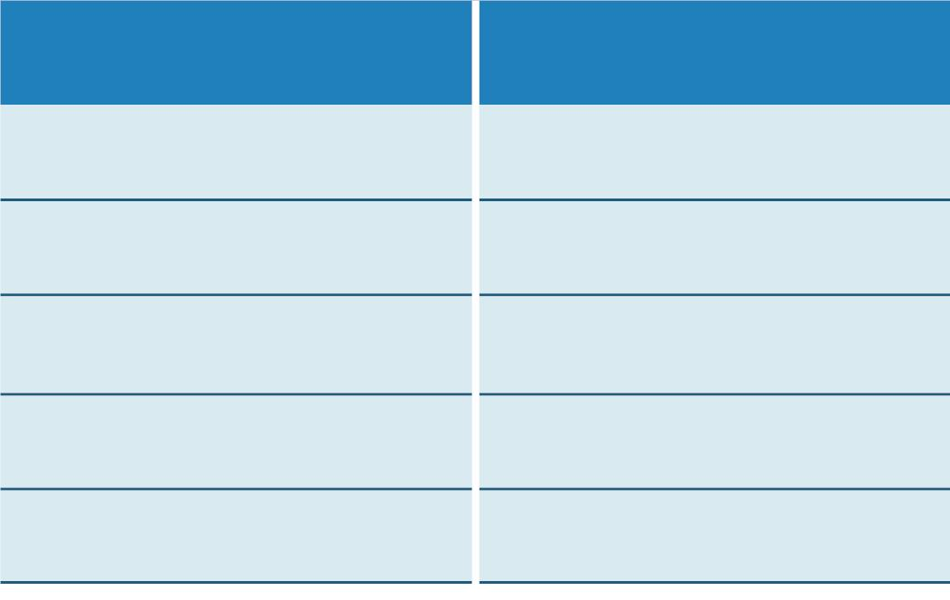
Project Details
Here is where you outline the Who, What, Where, When, and How of the
project, as well as your speciﬁc contract terms. Depending on the nature of the
project, you might also include a timeline and pricing table.
Timeline
Task
Timeline
Initial research
Completed within two weeks

Slide 4
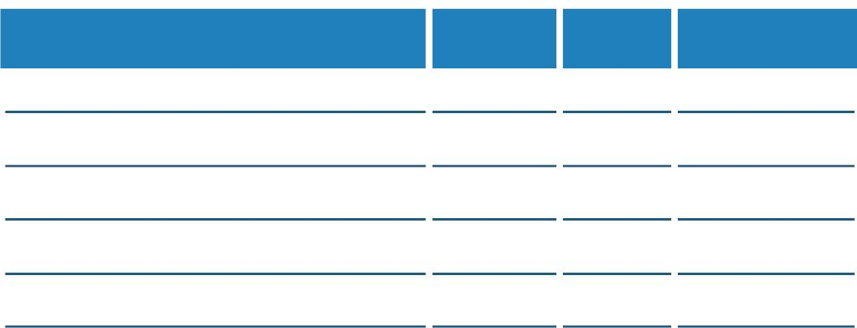


Project Estimate
Item
Cost Qty Subtotal
Subtotal:
Taxes:
Discount(s):
Total:
Terms
Here is where you specify any important terms or limitations relating to the
project. These caveats can protect you from committing additional work or
liability in the event of unforeseen problems—at least, not without additional pay.
An example might be:
"[Your Company Name] will service all technical issues involving [Your
Specialties]. We reserve the right to charge extra in the event of an issue that is
not listed above."

Slide 5

Conclusion
For the conclusion, repeat the main points of your proposal once again. You
should also conclude with a call to action that encourages the reader to contact
you or visit your website for more information. Ideally, you want your client to
take immediate action, even if it is something small.
Agreement
If your proposal is going to double as a contract agreement, here is where you'll
outline the ﬁnal terms and ask for a signature.
An example might include:
"By signing below, [Client Name] agrees to the terms of this proposal and will
enter a contractual agreement with [Your Name] beginning on the date of
signing."
Vendor Signature
Your Signature
Vendor Name (print)
Your Name (print)
Date
Date

