Slide 1
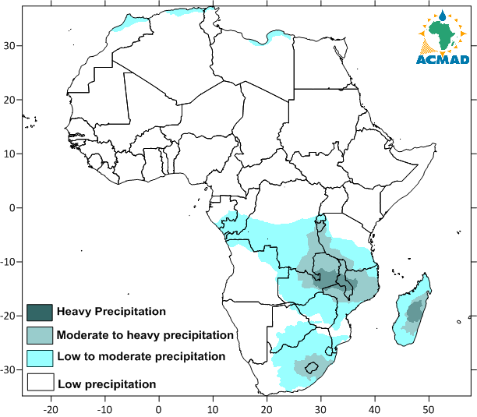
PRECIPITATIONS FORECAST FOR THE UPCOMING TWO WEEKS
Precipitation Outlook for week-1(14th -20 January 2022)
Precipitation Outlook for week-2(21st -27 January 2022)
Figure 39: Precipitation Outlook for week-1(left panel) and week-2 (right panel)

